Slide 1






PDS
Computer Vision
Migration
Virtualization
Cloud Computing
@ P. Siagian
https://github.com/siagianp
https://www.youtube.com/@AmelOline/videos
https://github.com/amelcharolinesgn2/IoT_simulator-mqtt-NodeRed
https://github.com/amelcharolinesgn2/Cloud-Infrastructures
https://github.com/amelcharolinesgn2/ClouD-Infrastructure-SISKA-2025
https://github.com/amelcharolinesgn2/Gyroscope-Sensor-Data-Accelerometer
https://github.com/amelcharolinesgn2/cloudSim
https://github.com/amelcharolinesgn2/CCNA 1
Notes:
data communication simulator
https://github.com/yetanalytics/datasim
Quantum Communication Simulator
https://github.com/Slygriyrsk/quantum-communication-simulator
MIL-STD-1553-Simulator
MIL-STD-1553 is a serial communication protocol that is used in spacecrafts for internal communication. A spacecraft consists of various components like main computer, star tracker, fly wheel, temperature sensor, cameras (also called as Remote Terminals) etc. The main computer needs to communicate with all the other peripherals to get the data and send it to ground station for further processing. This internal communication is done by a serial bus called MIL-STD-1553. This repository contains a simulation for this protocol. It can be used to create any space applications by importing the simulator into your code.
MIL-STD-1553 has Bus Controller that orchestrates the transmission and reception of data on the serial bus. It always initiates the communication and commands Remote Terminal for sending or receiving data. Only one node or Remote Terminal can send data on the bus at a given moment when ordered by the Bus Controller. The details of the protocol can be found in MIL-STD-1553 Tutorial and Reference document by Alta dt.
About This Repository:
This repository segregated based on various components that are described in the MIL-STD-1553 standard. Two of the most important components are Bus Controller and Remote Terminals. For a small network, one serial bus can handle up to 31 remote terminals and one bus controller. This repository is divided into two parts. Bus Controller Simulator and Remote Terminal Simulator. Both the components have separate set of functionalities.
Bus Controller Simulator : This simulator is responsible to understand the requirements from the Flight Software or Spacecraft computer and send commands and data to Remote Terminal.
Remote Terminal Simulator : This simulator is responsible for understanding the commands or data comming from the Bus Controller and send status and data based on the requirements sent by the Bus Controller.
How To Use This Simulator
https://github.com/ShubhankarKulkarni/MIL-STD-1553-Simulator
This simulator uses ethernet communication instead of the actual physical communication that is mentioned in the standars. The standard is developed taking harsh and noisy conditions into account. The simulator majorly focuses on data layer of the standard. Based on this, you can either deploy both the simulators on the same machine and test it over the local loopback or you can deploy separate simulators on separate machines in a single subnet or same network.
You can run the following commands to run the simulators
python BC_Simulator.py
python RT_Simulator.py
python Simulator.py
Or you can uncomment a section of code in Simulator.py that creates threads for Bus Controller Simulator and Remote Terminal Simulator and then run the following command
python Simulator.py
Simulator.py only provides an example of how you can use BC and RT simulators. You can replace Simulator.py by any space application that needs to transfer any data using MIL-STD-1553. Apart from that, this whole repository is developed as a module. So, you can simply clone the repository into your application and can import it.
Arikatakur/Network-Transmission-Simulator
https://github.com/Arikatakur/Network-Transmission-Simulator
imulates network data transmission using the Stop-and-Wait protocol with acknowledgment packets. It includes:
Theoretical Calculator: Computes the time required to send a file under ideal conditions.
UDP File Transfer Tools: Sends files over a network using UDP and logs transmission details.
Experimentation Framework: Measures and compares theoretical vs. actual transmission times.
Features
Command-line interface for both theoretical calculations and actual file transmission.
Logs packet transmission details, acknowledgments, and final results.
Javadoc documentation for all classes and methods.
Test cases for robust verification.
Requirements
Java Development Kit (JDK) version 8 or higher.
Two computers on the same network for experimentation.
Tools:
iperf for bandwidth measurement.
Wireshark for packet analysis.
Design of data communication networks using simulation techniques
A Simulator for FANETs Using 5G Vehicle-to-Everything Communications and Named-Data Networking
https://arxiv.org/html/2510.13823v1

Slide 2


Cloud Migration
1

Slide 3
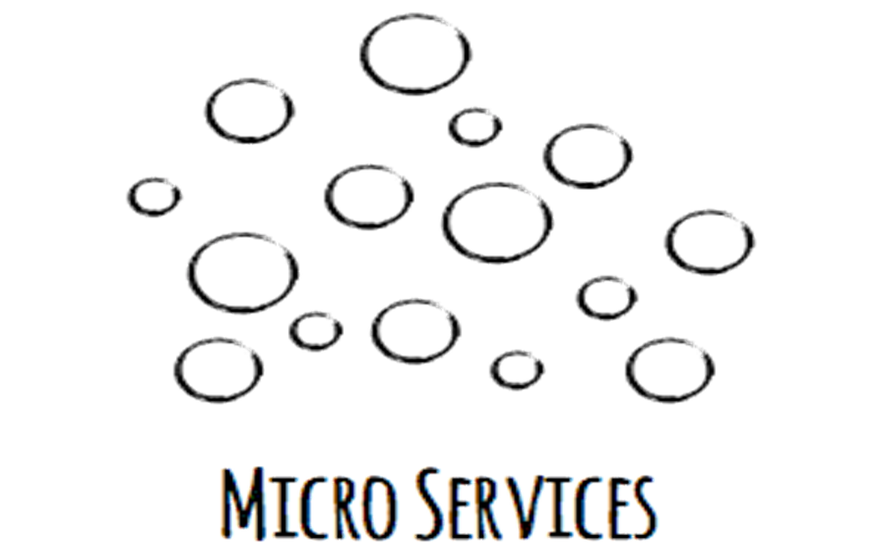
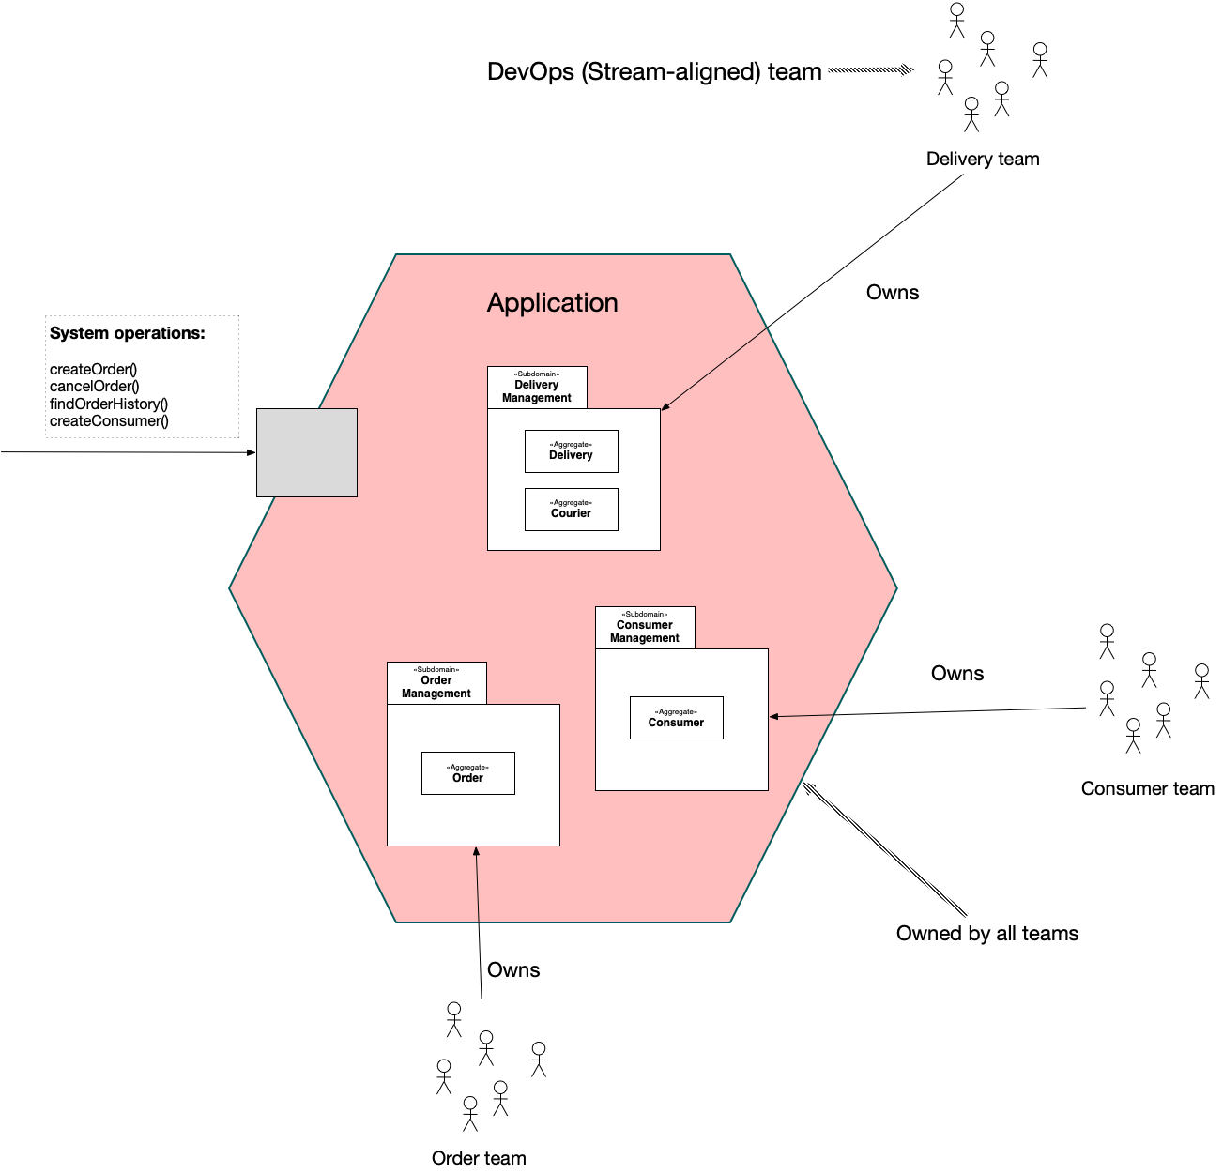
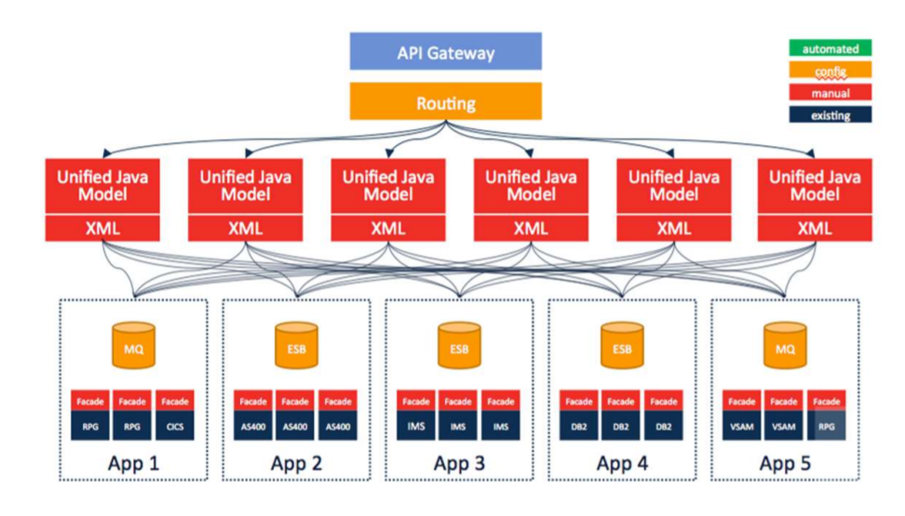
Identifying the Microservice & Monolithic Application?
Monolithic Application (Legacy Code)
Microservice Application (Legacy Code)

Slide 4
Why Microservice Migration In First Place ?
Microservice hosted as a Single Application.
Easy to Lift & Shift the application to Cloud Environment.
Easy to Figure out the Errors.
Don’t have Multiple Teams Involvement.
Don’t have Complex Architecture.

Slide 5
Migration Plan
M1 – Setup Test Environment Application (include Testing)
Setup test environment in Cloud.
Verifying the test environment.
Being Tracked in Jira/Trello.
Target Date –
Status –

Slide 6
M2 - Setup Integration Environment Target Date – | Status –
Setup Integration Environment.
Proper Testing of Latest Deployed Code.
Being Tracked in Jira/Trello.
M3 - Performance Testing Target Date – | Status –
Performance testing of application.
Being Tracked in Jira/Trello.
This will be done in the Integration Environment

Slide 7
M4 – Production Environment Target Date – | Status –
Setup Production Environment.
Proper Testing of Latest Deployed Code.
Being Tracked in Jira/Trello.
M5 – Infrastructure Monitoring Target Date – | Status –
Setup Cloud Watch Dashboard.
Automated Warning/Critical Infrastructure Notification.
Being Tracked in Jira/Trello.

Slide 8
M6 – DNS Cutover Target Date – | Status –
Traffic Monitoring during Ramp- up
Traffic Ramp-up Plan
Ramp-up to 10% traffic for 2 days
Ramp-up to 30% traffic for 2 days
Ramp-up to 50% traffic for 2 days
Ramp-up to 100% traffic

Slide 9
M7 – Secondary Region for DR Target Date – | Status –
Setup Data Recovery Environment.
Verifying DR Environment.
Being Tracked in Jira/Trello.
M8 – Setup Auto failover Target Date – | Status –
DNS Failover Changes.
Reduce the TTL value as much as possible, recommendation to make it 60 Sec.

Slide 10
M9 – Burn Down Activity Target Date – | Status –
Resource Utilization.
Verifying Resilience Plan.
M10 – Data Center Decommissioning Target Date – | Status –
Decommission the Data Center Servers.

Slide 11
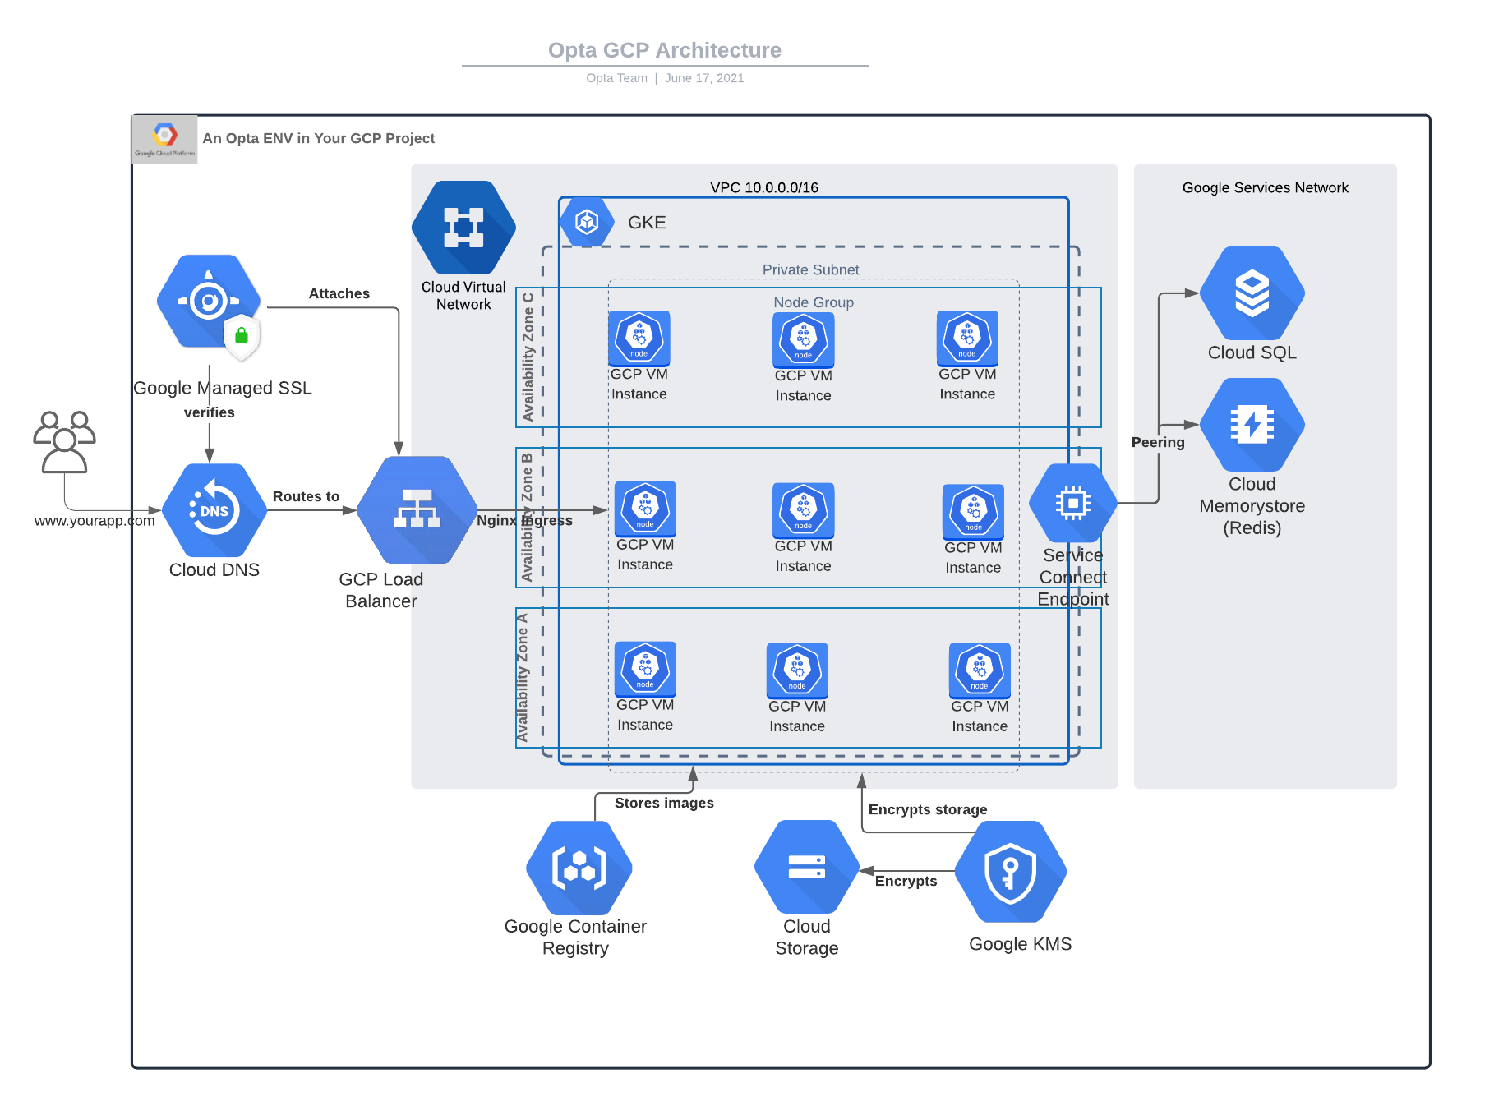
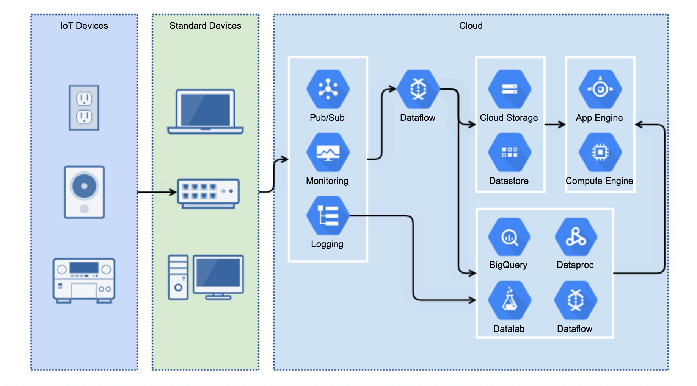
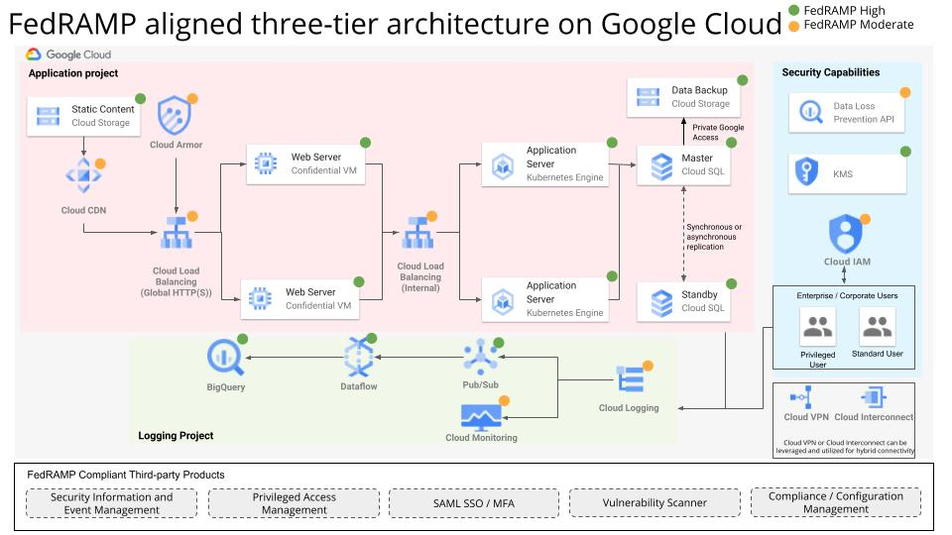
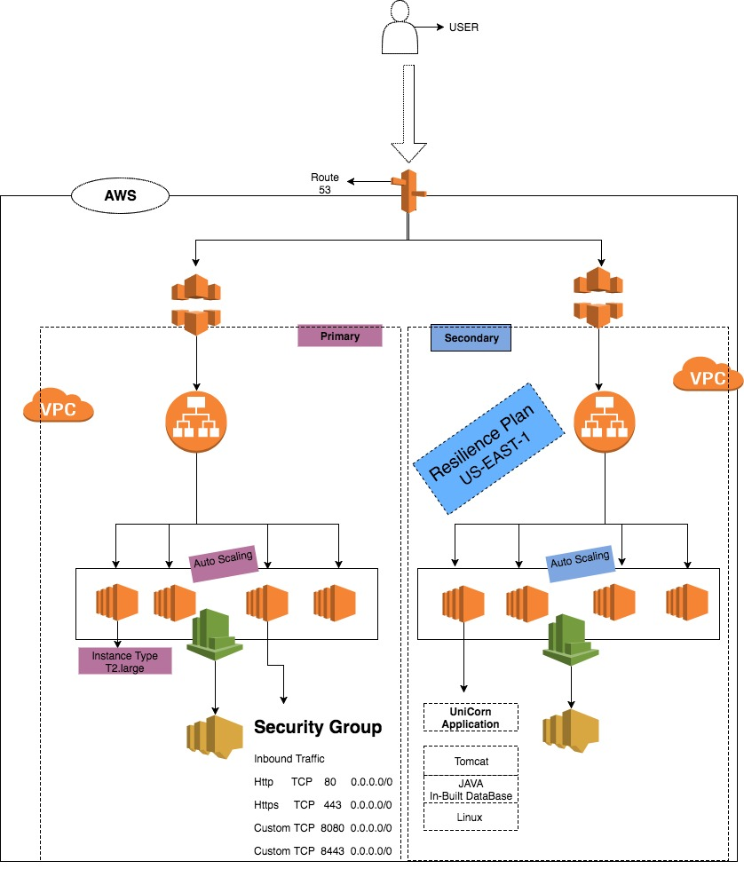
AWS Architecture
GCP Architecture
Notes:
https://www.google.com/imgres?q=GCP%20Architecture&imgurl=https%3A%2F%2Fwww.gliffy.com%2Fsites%2Fdefault%2Ffiles%2Finline-images%2Fgoogle-cloud-diagram-5.png&imgrefurl=https%3A%2F%2Fwww.gliffy.com%2Fblog%2Fgcp-architecture-diagrams&docid=yp5B5cKn3omWVM&tbnid=9AObwNC8VlvoJM&vet=12ahUKEwjj_aCE2-WWAxW8zjgGHX15CzcQnPAOegQIexAA..i&w=1838&h=1020&hcb=2&ved=2ahUKEwjj_aCE2-WWAxW8zjgGHX15CzcQnPAOegQIexAA

Slide 12
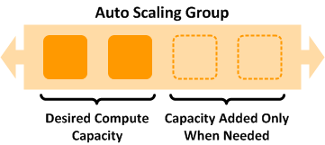
Why Auto Scaling ?

Slide 13
Auto Scaling Policies
CPU Utilization > 70 for 2 consecutive period of 300 second -> Add 1 Instance.
CPU Utilization > 80 for 2 consecutive period of 60 second -> Add 2 Instance.
CPU Utilization > 40 for 2 consecutive period of 600 second -> Remove 1 Instance

Slide 14
Cloud Watch Dashboards
Monitor Cloud Resource
Set Critical Alarms
Monitor Custom Metrics
View Graphs and Statistics

Slide 15

Why Resilience Plan Needed ?

Slide 16
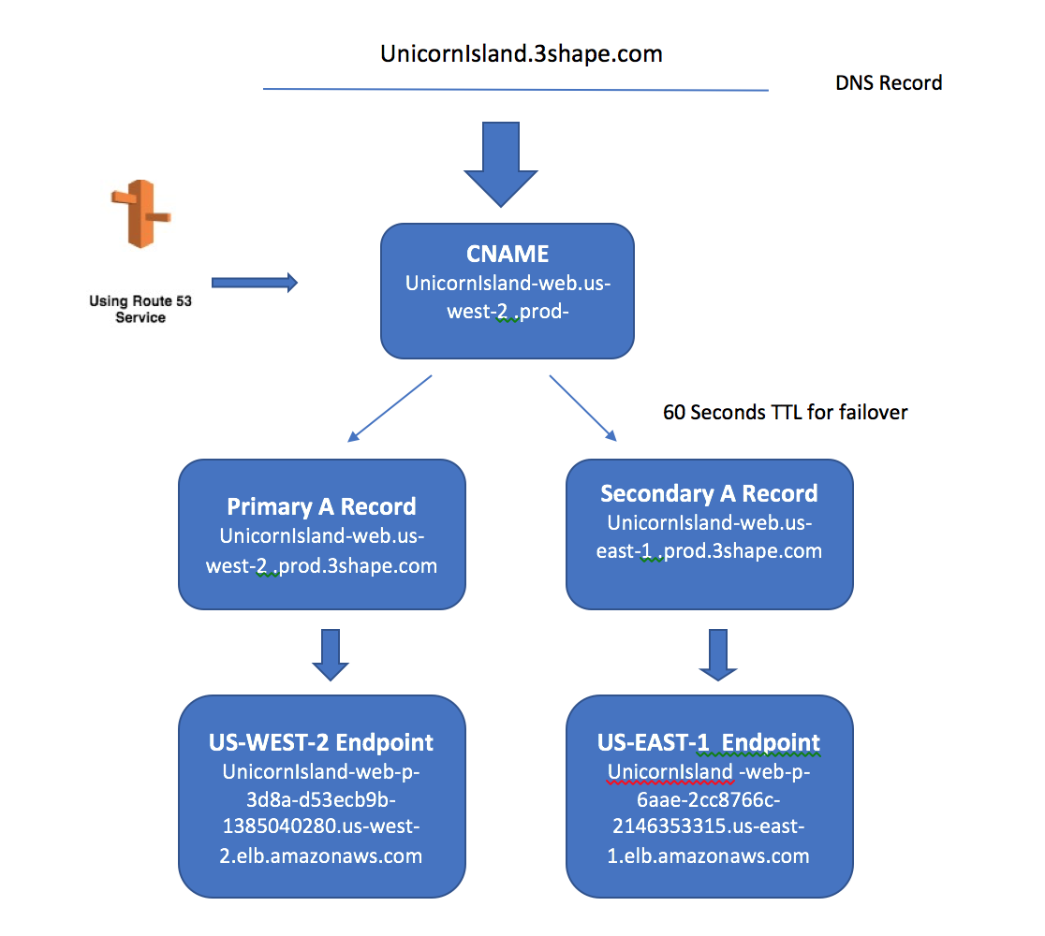
How AWS Router53 Works ?

Slide 17
Virtualization
2

Slide 18
Virtualisation: Concept
3
Virtualization is a technique, which allows to share a single physical instance of a resource or an application among multiple customers and organizations.
It does by assigning a logical name to a physical storage and providing a pointer to that physical resource when demanded.
Virtualization in cloud computing allows you to run multiple applications and OS on the same server, thereby providing for efficient resource utilization and reducing costs.

Slide 19
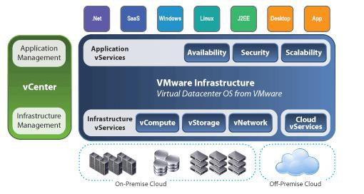
Virtualization Architecture
4

Slide 20
With the help of Virtualization multiple operating systems and applications can run on same Machine and its same hardware at the same time increasing the utilization and flexibility of hardware.
The machine on which the virtual machine is going to be build is known as Host Machine and that virtual machine is referred as a Guest Machine.

Slide 21
Hypervisor
5
The hypervisor is a firmware or low-level program that acts as a Virtual Machine Manager.
Hypervisor is a form of virtualization software used in Cloud hosting to divide and allocate the resources on various pieces of hardware.The program which provide partitioning, isolation or abstraction is called virtualization hypervisor.
Hypervisor is a hardware virtualization technique that allows multiple guest operating systems (OS) to run on a single host system at the same time. A hypervisor is sometimes also called a virtual machine manager(VMM).
There are two types of hypervisor:
Type 1 and Type 2

Slide 22
Types of Hypervisors
6
Type 1 hypervisors run directly on the system hardware. They are often referred to as a "native" or "bare metal" or "embedded" hypervisors in vendor literature. It dose not require any base server operating system.It has direct access to hardware resources
Type 2 hypervisors run on a host operating system that provides virtualization services, such as I/O device and memory management. Basically a software installed on an operatingThey are often referred to as a “Hosted Architecture" hypervisors in vendor literature.

Slide 23
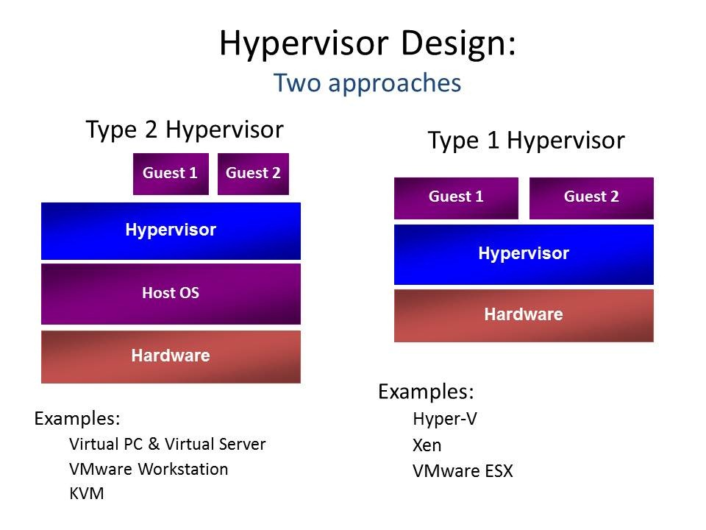
Type-1 Hypervisor
7

Slide 24
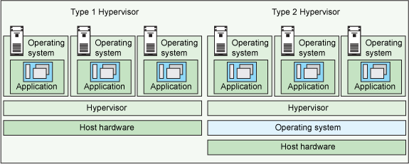
Hypervisors

Slide 25
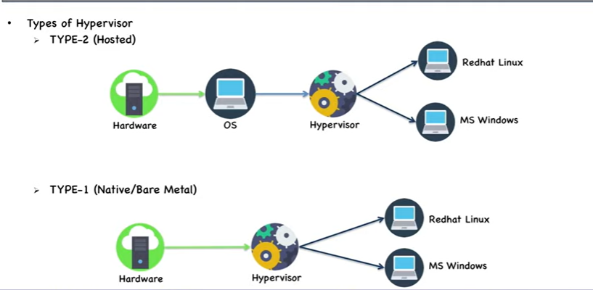
Type 1 and Type 2

Slide 26
Features of Type-1 and 2 Hypervisor
9
Type-1 Hypervisor:
provides better performance
provides greater flexibility
Servers that run Type 1 hypervisors are often single-purpose servers that offer no other function.
Type 1 hypervisors are production hypervisors or hypervisors that run VMs offering services to users.
support hardware virtualization.
Type-2 Hypervisor:
Less efficient
Less flexible
offer a series of different services.
rarely used in production.
perform software virtualization.

Slide 27
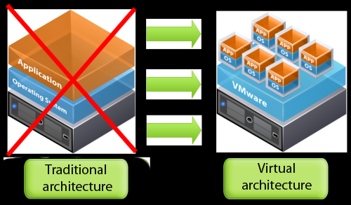
Virtualization

Slide 28
Types of Virtualization
11
Hardware Virtualization
Software Virtualization
Memory Virtualization
Storage Virtualization
Data Virtualization
Network Virtualization
Desktop Virtualization

Slide 29
Hardware Virtualization
12
Hardware virtualization also known as server virtualization runs on the concept that an individual independent segment of hardware or a physical server, may be made up of multiple smaller segments of hardware or servers, essentially consolidating multiple physical servers into virtual servers that run on a single primary physical server.

Slide 30
Hardware Virtualization:
Subtypes
13
Full Virtualization –
The underlying hardware is fully simulated.
Guest software does not require any modifications.
Para-virtualization –
The hardware is not simulated instead the guest software run their own isolated domains.
Emulation Virtualization –
The virtual machine simulates the hardware and becomes independent of it.
Guest software does not require any modifications.

Slide 31
Full virtualization is a common and cost-effective type of virtualization, which is basically a method by which computer service requests are separated from the physical hardware that facilitates them.
With full virtualization, operating systems and their hosted software are run on top of virtual hardware.
It differs from other forms of virtualization (like paravirtualization and hardware-assisted virtualization) in its total isolation of guest operating systems from their hosts.

Slide 32
Full virtualization
Full virtualization is fulfilled by the use of both binary translation and direct execution.
In full virtualization, the guest OS is completely isolated by the virtual machine from the virtualization layer and hardware.
Microsoft and Parallels systems are examples of full virtualization..

Slide 33
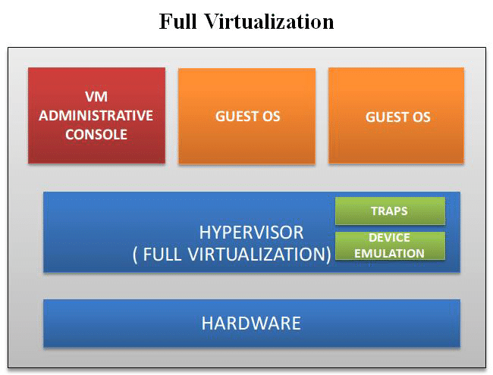
Fig.

Slide 34
Para-virtualization
Paravirtualization is the category of CPU virtualization which uses hypercalls for operations to handle instructions at compile time.
In paravirtualization, guest OS is not completely isolated but it is partially isolated by the virtual machine from the virtualization layer and hardware.
VMware and Xen are some examples of paravirtualization..

Slide 35
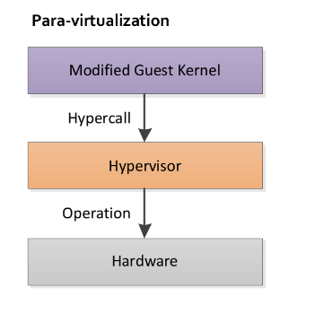
Fig.

Slide 36
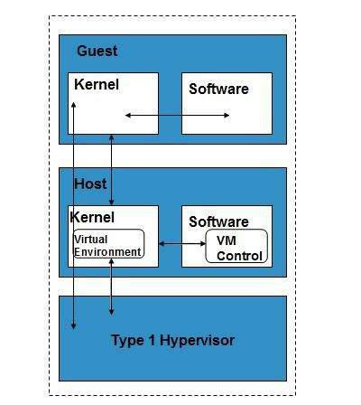
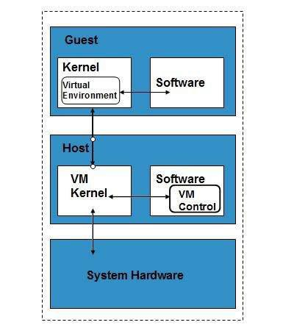
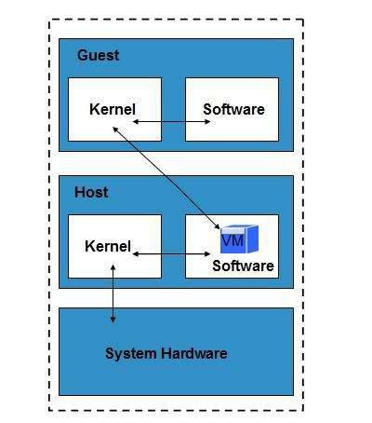
Hardware Virtualization:
Subtypes
14
Full Virtualization
Para Virtualization
Emulation

Slide 37
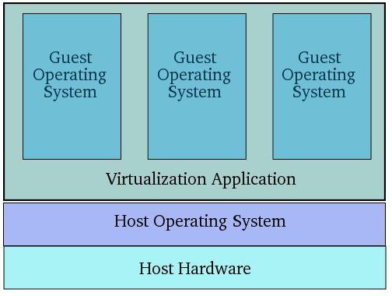
Software Virtualization
15
Software Virtualization involves the creation and operation of multiple virtual environments on the host machine.
It is used to enable a complete computer system in order to allow the guest operating system to run.
For instance, letting LINUX OS to run as a guest that is natively using a Microsoft Windows OS.

Slide 38
Software Virtualization :Subtypes
16
Operating System Virtualization –
hosting multiple OS on the native OS
Application Virtualization –
hosting individual applications in a virtual environment separate from the native OS
Service Virtualization –
hosting specific services related to a particular application.

Slide 39
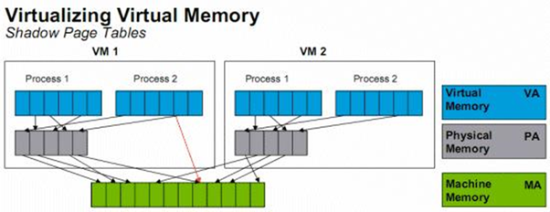
Memory Virtualization
17
Physical memory across different ser vers i s aggregated into a single virtualized memory pool.
It provides the benefit of an enlarged contiguous working memory.
For instance, as some OS such as Microsoft Windows OS allows a portion of your storage disk to serve as an extension of your RAM.

Slide 40
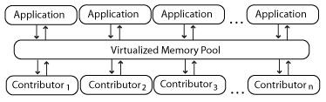
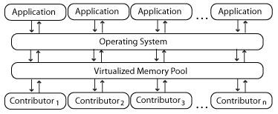
Memory Virtualization: Subtypes
18
Application-level control – Applications access the memory pool directly.
Operating system level control – Access to the memory pool is provided through an operating system.

Slide 41
Storage Virtualization
19
Multiple physical storage devices are grouped together, which then appear as a single storage device.
This provides various advantages such as homogenization of storage across storage devices of multiple capacity and speeds, reduced downtime, load balancing and better optimization of performance and speed.
Partitioning your hard drive into multiple partitions is an example of this virtualization.

Slide 42
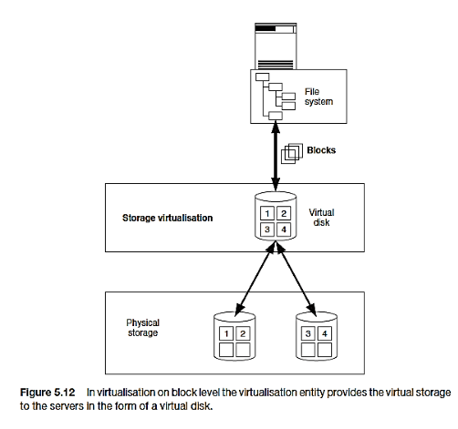
Storage Virtualization: Subtypes
20
1. Block Virtualization – Virtualisation on block level means that storage capacity is made available to the operating system or the applications in the form of virtual disks.

Slide 43
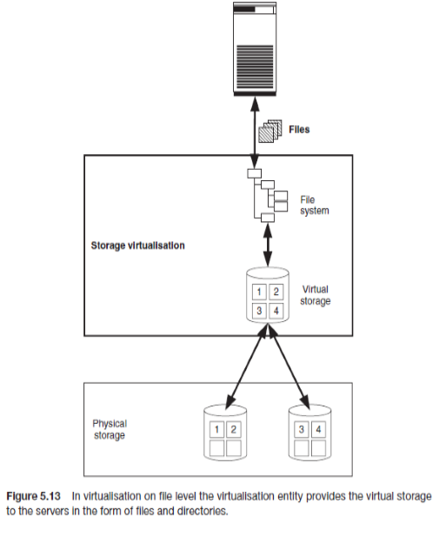
Storage Virtualization: Subtypes
2. File Virtualization
Virtualisation on file level means that the virtualisation entity provides virtual storage to the operating systems or applications in the form of files and directories

Slide 44
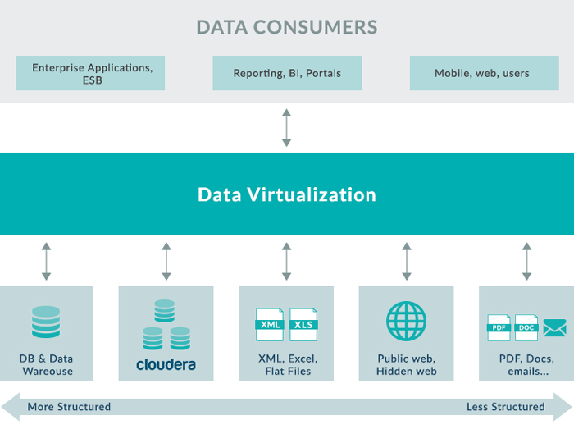
Data Virtualization
21
It lets us to easily manipulate data, as the data is presented as an abstract layer completely independent of data structure and database systems.
Decreases data input and formatting errors.

Slide 45
Network Virtualization
22
In network virtualization, multiple sub-networks can be created on the same physical network, which may or may not is authorized to communicate with each other.
This enables restriction of file movement across networks and enhances security, and
allows better monitoring and identification of data usage.
It also increases reliability as a disruption in one network doesn’t affect other networks, and the diagnosis is easier.

Slide 46
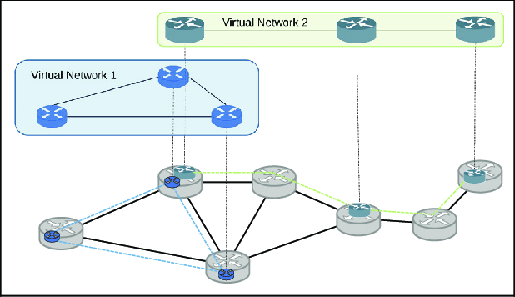
Network Virtualization :Subtypes
23
Internal network:
Enables a single system to function like a network
External network:
Consolidation of multiple networks into a single one, or segregation of a single network into multiple ones

Slide 47
Desktop Virtualization
24
This is perh a p s t h e m o s t c o m m o n fo r m o f virtualization for any regular IT employee.
The user’s desktop is stored on a remote server, allowing the user to access his desktop from any device or location.
Employees can work conveniently from the comfort of their home. Since the data transfer takes place over secure protocols, any risk of data theft is minimized.

Slide 48
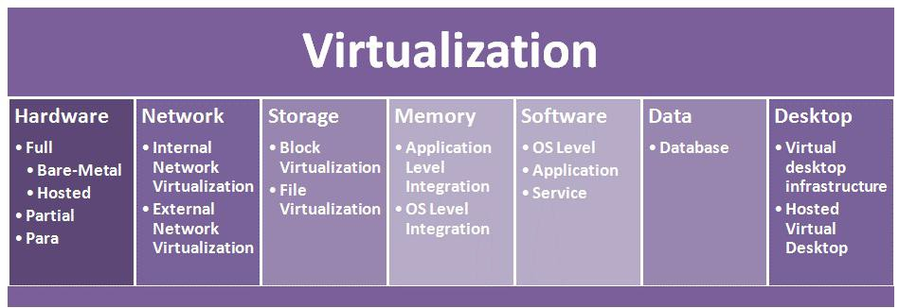
Types of Virtualization: At a
Glance
25

Slide 49
Benefits of Virtualization
26
Easily outsource your hardware and eliminate any energy costs associated with its operation.
the efficiency, security and cost advantages.
Run operating systems where the physical hardware is unavailable.
Easier to create new machines, backup machines, etc.
Software testing using “clean” installs of operating systems and software
Emulate more machines than are physically available.
Timeshare lightly loaded systems on one host.
Easy migration of virtual machines (shutdown needed or not).

Slide 50
Cloud Infratructure
3

